Slide 1
IBM MQ OASIS
LegalXML ECF SIP

Slide 2
SIP Requirements
Transport Protocol - how physically transported
MDE Addressing - convention for unique addresses
Operation Addressing - unique MDE addresses
Synchronous Mode Response
Asynchronous Mode Response
Message/Attachment Delimiters - how messages are distinguished from attachments
Message Identifiers - how messages are uniquely identified

Slide 3
SIP History
Early spec (1.0) limited interoperability.
Courts using different architectures.
Layered interoperability.
SIP defines messaging infrastructure for how messages get from sender to receiver.
Core Spec only defines the messages.
Implementers not limited to published SIPs.
JRA SIPs based on ECF SIPs

Slide 4
Other SIP Issues
Message non-repudiation
Message Integrity
Message Confidentiality
Message Authentication
Message Transmission Reliability
Message Splitting and Assembly
Transmission Auditing

Slide 5
MQ Basics
Asynchronous program to program communication.
Messages consist of two parts; a message header, and the payload.
Messages can be grouped. Order is preserved.
Message size up to 100MB per message.
Messages can be segmented. Segmentation can be invisible to the applications, or can be segmented by the sending application.
Messages can be persistent – delivery is assured, and messages survive system failures.
Provides a programmable interface (API).
Synchpoint control – transactional commit and backout.
CorrelationID to link Reply message to Request message.

Slide 6
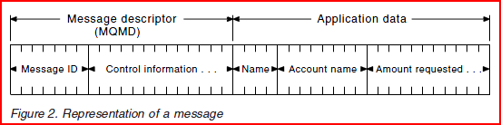
MQ Message Anatomy

Slide 7
MQMD
Message Information
DocumentAttachment
ECF XML
Document Rendition
FilingLeadDocument1
DocumentAttachment
DocumentRendition
FilingLeadDocument2
DocumentAttachment
DocumentRendition
FilingConnectedDocument1
DocumentAttachment
DocumentRendition
FilingConnectedDocument2
MQ Payload
MQ Payload
Electronic Court Filing 4.0 Message (XML)
MQMD
Attachment 1
Document Binary (PDF)
MQMD
Attachment 2
Document Binary (PDF)
MQMD
Attachment 3
Document Binary (PDF)
MQMD
Attachment 4
Document Binary (PDF)
Electronic Court Filing 4.0 Message Stream
MQ Message Group

Slide 8
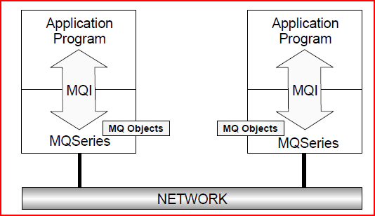
Most Basic

Slide 9
MQ Addressing
  Hostname - 192.168.96.117
  Port - 1414
  Channel - DEV.TURBOCOURT
  MQ Manager - AOC_DEV01
  Queue Names
    Request (RecordFiling) - DEV.EFILE.SUBMIT.AZTC.INPUT
    Response (NotifyDocketingComplete) - DEV.EFILE.NOTIFY.AZTC.REPLY
    Request (GetCaseList, GetCase) – DEV.EFILE.QUERY.AZTC.INPUT
    Request (GetCaseList, GetCase) – DEV.EFILE.QUERY.AZTC.REPLY

Slide 10
RecordFilingRequest

Slide 11
AOC MQ Message Routing
Message routing is accomplished through the use of the message’s ApplicationID. The AOC has a specific format for the ApplicationID that must be present in all messages being routed through its queues.
AppID(19) = TargetCd(5) + InterfaceCd(5) + OriginatorCd(9)
TargetCd Identifies where the data is going (i.e. a code that identifies the database that will store the data). Can be negotiated, but should describe the recipient (generally of the form Cxxxx where xxxx is the CCI court code and C denotes court).
InterfaceCd Identifies the type of information being passed, which in turn, determines which interface to call, i.e. 00004 = Citation Legacy. Assigned by the integration group and denotes an individual interface or message type.
OriginatorCd Identifies where the data came from; the first four digits indicate the county, the text portion indicates the type of entity that sent the data (vnd = vendor, mun = municipal) and the following digits indicate a sequence for that combination. Value is assigned by the MQ group (e.g. Norrie) and is used for their own purposes.
The combination of TargetCd and InterfaceCd must resolve to a unique queue.

Slide 12
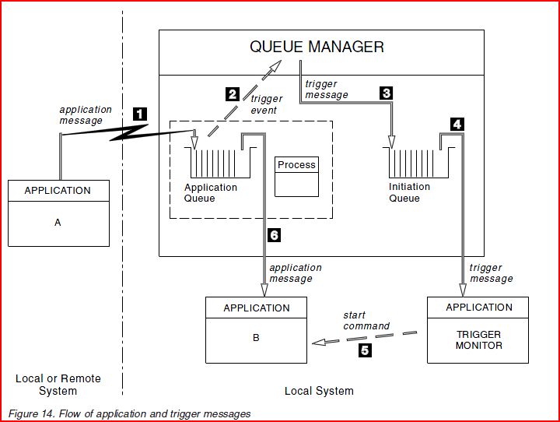

Slide 13
TP Sequence of Events
1. Application A, which can be either local or remote to the queue manager, puts a message on the application queue.
2. The queue manager checks to see if the conditions are met under which it has to generate a trigger event. They are, and a trigger event is generated. Information held within the associated process definition object is used when creating the trigger message.
3. The queue manager creates a trigger message and puts it on the initiation queue associated with this application queue, but only if an application (trigger monitor) has the initiation queue open for input.
4. The trigger monitor retrieves the trigger message from the initiation queue.
5. The trigger monitor issues a command to start application B (the server application).
6. Application B opens the application queue and retrieves the message.

Slide 14
XSD Replaces WSDL
TurboCourt-MessageExchangeDefinitions.xsd
<xsd:complexType name="RecordFilingRequestType">
<xsd:complexContent>
<xsd:extension base="s:ComplexObjectType">
<xsd:sequence>
<xsd:element ref="docket:RecordDocketingMessage" minOccurs="0" maxOccurs="unbounded"/>
<xsd:element ref="core:CoreFilingMessage"/>
<xsd:element ref="payment:PaymentMessage"/>
</xsd:sequence>
ECF-WebServicesProfile-Definitions v2.1.wsdl
<xsd:complexType name="RecordFilingRequestMessageType">
<xsd:complexContent>
<xsd:extension base="ecf:ElectronicFilingMessageType">
<xsd:sequence>
<xsd:element ref="docket:RecordDocketingMessage"/>
<xsd:element ref="core:CoreFilingMessage"/> </xsd:sequence>

Slide 15
NotifyDocketingComplete

Slide 16
GetCase, GetDocument

Slide 17
MDEs

Slide 18
Components Collaboration

Slide 19
Record Filing Request

Slide 20
Topology

Slide 21
Transferring Documents Flow

Slide 22
    AZ Statewide E-Filing using ECF 4.0

Slide 23
FA MDE
Filing Review MDE
CR MDE
Public Access
FR/CR MDE
CMS
EFSP
EFM
AZ AOC MDE
Clerk Review
Turbo Court EFSP
Turbo Court EFM
Court Record MDE
DMS
CCI
CDR
Turbo Court Clerk Review

Slide 24
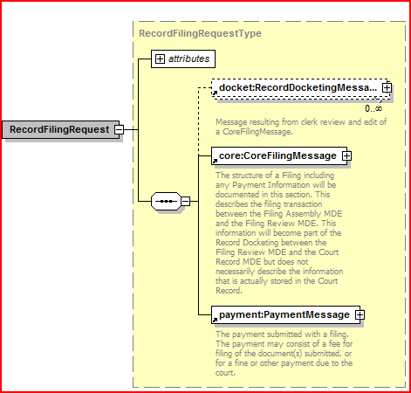
RecordFilingRequest

Slide 25
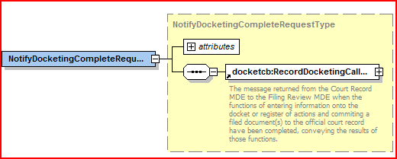
NotifyDocketingCompleteRequest

Slide 26
