Slide 1
Arrested Development: The Cardinality Effect
ECF TC Position Paper

Slide 2
CTC 2015 Keynote
Mark Britton, Keynote Speaker on “The Innovative Imperative”
Courts treat judicial services as though it were a monopoly, devoid of competition
Private sector is competing with Judiciary to improve Access to Justice, provide affordable arbitration services, reduce costs typically associated with court backlogs, and offer DYI services
Courts accused of not innovating and embracing change to improve the customer experience
Source: http://www.ctc2015.org/

Slide 3
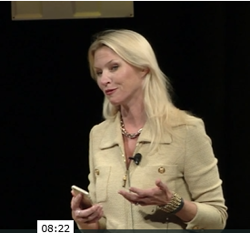
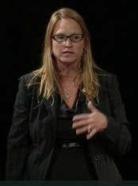
CTC 2015 Endnote
Laurie Dudgeon and Heather Petit, Endnote Speakers on “Tying it All Together”
Exploit opportunities that focus on improving the customer experience, e.g., DYI kiosks and online services, online judge support information systems, mobile technology
Don’t automate current processes
Chase technology and overcome fear of change
Source: http://www.ctc2015.org/

Slide 4
CTC 2015 What’s Happening
What’s Happening
Lots of judges and clerks are rethinking social media. Some had written it off as a fad but it's clearly not
@Mark_Britton keynote made us uncomfortable - that was a good thing. Really
Source: http://www.ctc2015.org/

Slide 5
The Issue
Bounded element cardinality

Slide 6
Effects Cardinality Has on Flexibility
Constrained XML elements
Cannot be controlled by constraint schema
Cannot be extended
Must be replaced if extension is needed
Are costly to develop and maintain
Are unnecessary (if unbounded)
Should be considered a last resort
Unbounded XML elements
Can be locally controlled by constraint schema
Can be extended
Are cost-effective to extend and maintain
Should be considered the first option

Slide 7
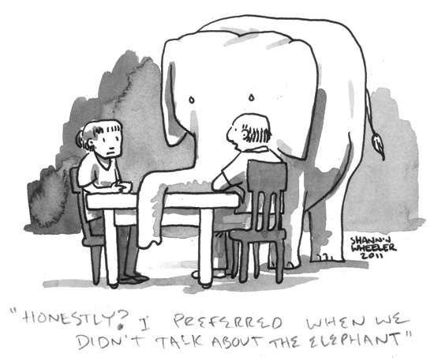
Elephant in the Room
Reality Check: FAMDEs, FRMDEs (EFM, Clerk Review), CRMDEs, and middleware are developed by both vendors and courts
FAMDEs, FRMDEs, CRMDEs, and middleware have different support capabilities, but must work together
Courts have ever-changing business needs
No two courts are the same
Vendors must adapt their solutions to meet varying court needs
Vendors and courts must control costs

Slide 8
Does ECF Readily…
Enable features and functions that satisfy a Court’s changing business conditions?
Adapt to the differences in MDE capabilities?
Improve service delivery and time-to-market?
Provide upward and downward scalability?
Provide a means to control development and maintenance costs?
In a constrained cardinality model, one size cannot possible fit all

Slide 9
For ECF to Succeed, Synergy and Compromise are Required
Business Needs
ECF Capabilities
FAMDE Capabilities
CRMDE Capabilities
FRMDE Capabilities

Slide 10
What Problem Should We Be Solving?
How can vendors and courts freely innovate, using LegalXML ECF as the framework for inter-system communications, in the most effective and efficient manner possible?

Slide 11
What Can be Done?
Alternatives and Recommendations

Slide 12
Alternative Approaches
Leave element constraints unbounded
Constrain all elements
Constrain elements ONLY based on an agreed upon set of rules; and when we don’t know, leave element unbounded
Implement inter-MDE cardinality “contracts” via Court Policy
Incorporate element cardinality reference models in ECF specification:
Minimal/simple implementation model
Typical mainstream implementation model
Freedom to innovate implementation model
Others…?
Do nothing

Slide 13
Recommendation
Adopt one or more of the Alternative Approaches outlined, e.g.,
Enable implementers to adapt their respective technologies to meet customer needs “on demand” (suggests unboundedness and/or Court Policy “contracts”)
Incorporate reference models in ECF specifications that illustrate how ECF can be used for various types of implementations
Others…?

Slide 14
What’s Next?
Discussion?
Motion?

