Slide 1
XACML in real-world applications
www.oasis-open.org
Doron Grinstein, CEO BiTKOO
doron@bitkoo.com
+1-818-985-4700
888-4-BiTKOO
http://www.bitkoo.com

Slide 2
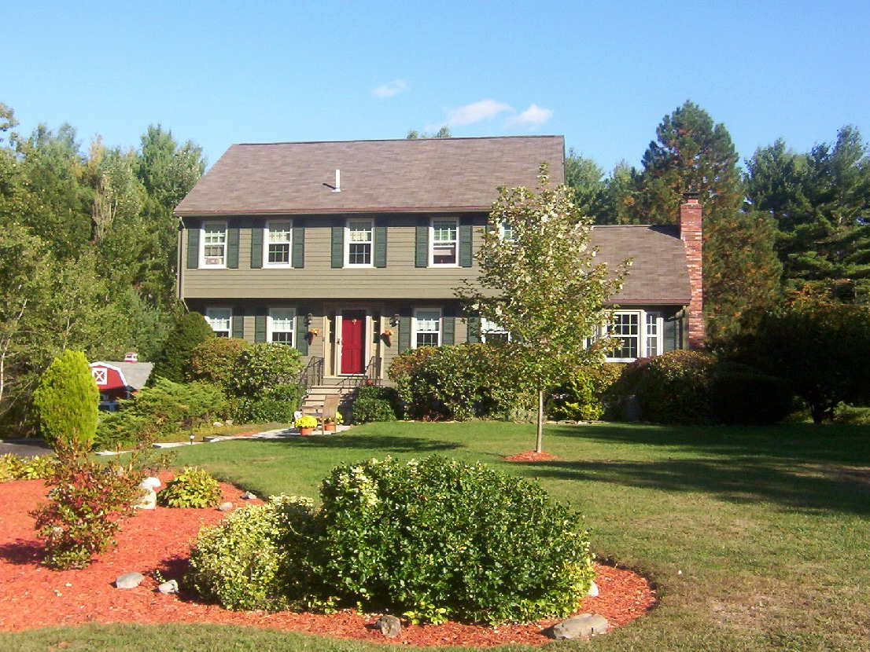

Slide 3
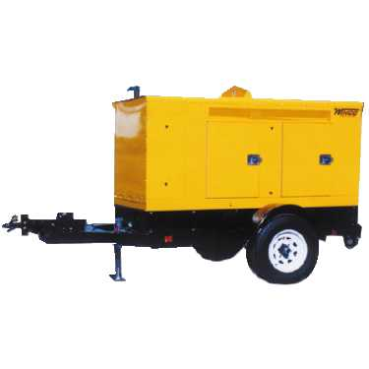
Notes:
Imagine a world in which your house lights run on a propane generator, your air condition runs on a diesel generator and some other appliances run on other types of generators, such as gasoline.
This would be absurd, right?
If you look at how organizations handle the security of their applications, you can draw an analogy to that of the house with the various generators.
What is wrong with implementing security as so many incompatible way?
Implementation and administration costs are much higher (will explain)
Security suffers (will explain)
Compliance is virtually impossible (will explain)

Slide 4
Notes:
By consuming standards-based web services that provide authentication and authorization, applications of any kind can be written faster and never be modified as a result of security rule changes or a migration to different or additional authentication providers.

Slide 5
www.oasis-open.org
You can apply security consistently
Java Applications
JSP, JSF, CXF
.NET Applications
ASP.Net, Silverlight, WCF, WPF
SharePoint 2010
IIS Hosted Apps
Apache Hosted Applications
SQL Server
Rows, columns, and cells in databases
DB-2
Oracle Databases
Networks
MySQL
Business processes, new applications, services…

Slide 6
www.oasis-open.org
XACML Allows Security Consolidation
“Data on client XYZ should be available in SharePoint to all non-legal staff only if the current date is after the gag order is lifted. Legal staff require full access, but we need to audit their activity to ensure data isn’t leaked.”
Traditionally
Multiple user interfaces
IT had to be involved in policy changes
Limitations on each application based on pre-defined model of security
Code changes required to adapt to new security concepts
XACML
Express any security policy or rule
Develop new security concepts without modifying existing applications
Use of a single interface to manage policies for all applications
The business is empowered to make policy changes

Slide 7
www.oasis-open.org
XACML scales!
Attribute caching
Decision caching
Compiling policy to intermediate language
XACML is stateless so it scales horizontally
PDPs can be deployed with PEPs
Combined with federation
XACML done right performs and scales to the cloud

Slide 8
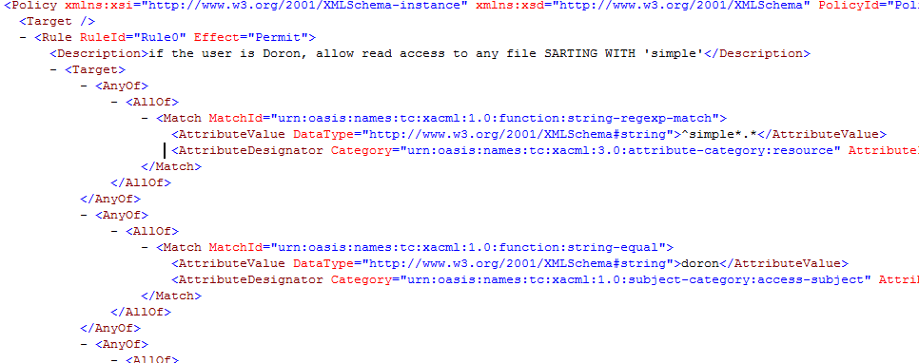
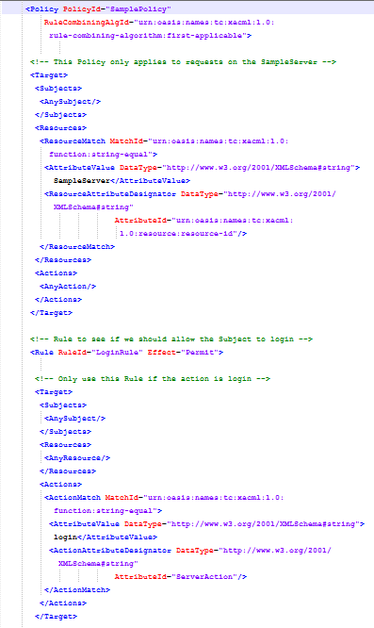
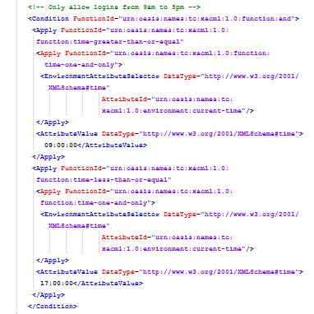
www.oasis-open.org
Business Users Should not see XML
Products exist that help business users manage XACML by providing
Simple API
Web service API
Command-line interface
Domain-specific languages
A graphical user interface (GUI)
More to come..
Some users might accept editing this
But policies are typically more complex
This code is used to express specific login times on a single server

Slide 9
www.oasis-open.org
Leverage RBAC and ABAC
“Data on client XYZ should be available in SharePoint to all non-legal staff only if the current date is after the gag order is lifted. Legal staff require full access, but we need to audit their activity to ensure data isn’t leaked. John Doe is the only non-legal exception, and must also have access.”
John Doe
“Exceptions” group defined in Active Directory
In Active Directory, Department = “Legal” AND in LDAP 3 DeptNum = 46
Attribute definition of legal staff spans directories
HushDate in custom SQL Database = ‘2011-06-28 04:00:00.000’
Gag order release date is defined in a custom-built legal application

Slide 10
Thank you!
Visit us on the web at http://www.bitkoo.com

