Slide 1
OASIS Open Smart Grid Reference Model:
Standards Landscape Analysis
September 30, 2011

Slide 2
Standards Landscape
Many organizations doing excellent work
High level of activity
Industry Standards focused on interoperability within specific domains
Architectural Efforts focused on broad coverage of smart grid requirements

Slide 3
Industry Standards
Core focus on interoperability within specific domains:
IEC – detailed specifications for object models, data interchange, functional interaction, industry interaction (e.g. IEC 61968, 61850, etc.)
OpenSpeak, DNP3, OPC – power system communications
ANSI – detailed specifications for object models, device communications (e.g. ANSI C12.19)
OpenHAN, OpenADR, ZigBee, ZWave, etc. – product standardization and interoperability for focused domains
IEEE Power & Engineering – advancement of science; standards to guide the development of interoperable equipment and power systems (e.g. IEEE P2030)
NIST SGIP – develops use cases, identifies requirements, and proposes action plans for standards development and harmonization

Slide 4
Architectural Efforts
Efforts to create broader smart grid frameworks
NIST Smart Grid Interoperability Panel
Gridwise Architecture Council
Edison Power Research Institute Intelligrid
Microsoft Smart Energy Reference Architecture (SERA)
SAP Lighthouse Council
IBM SAFE

Slide 5
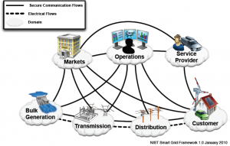
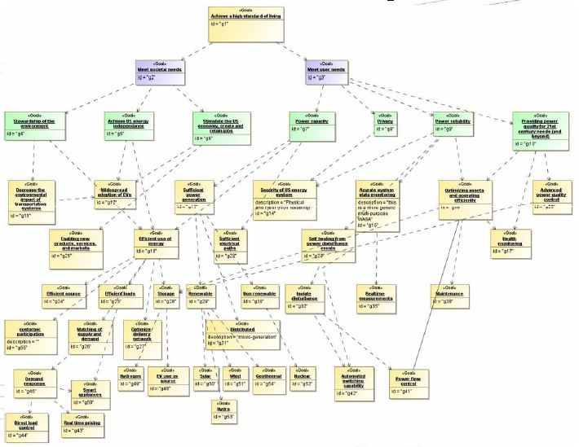
NIST SGIP
Mission: provide a framework for coordination of all SG stakeholders to accelerate standards harmonization and development
The SGIP does not write standards, but instead develops and reviews use cases, identifies requirements, and proposes action plans for standards development and harmonization.
• Goals derived from national legislation (9500 pages)
• Use cases (655) and requirements (20 documents) are initially assumed valid

Slide 6
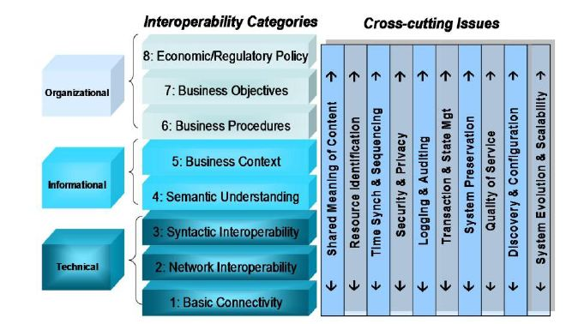
Gridwise Architecture Council
The GridWise Architecture Council (GWAC) enlists industry involvement to:
Articulate the goal of interoperability across the electric system
Identify the concepts and architectures needed to make interoperability possible
Shaping guiding principles, or architecture, for intelligent and interactive electric system

Slide 7
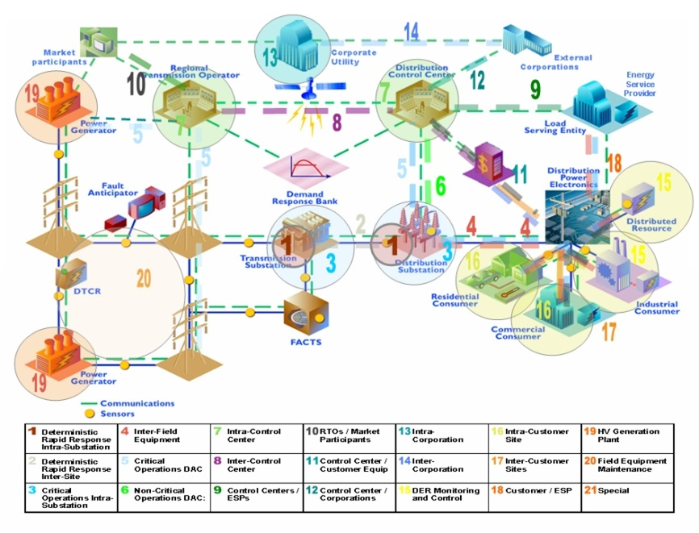
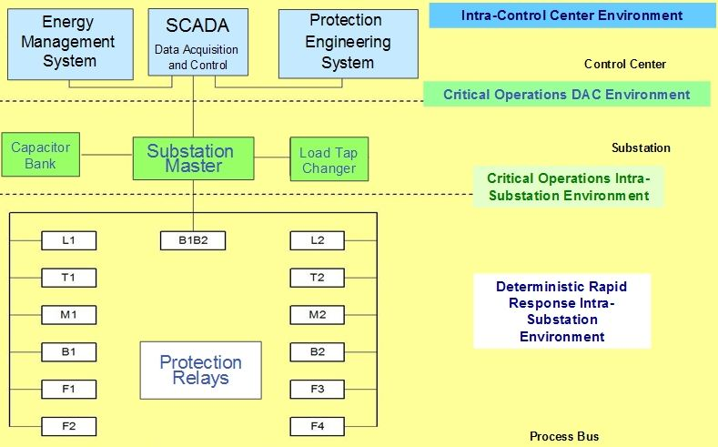
EPRI Intelligrid
Technical foundation for a smart power grid that links electricity with communications and computer control
Open-standards, requirements-based approach for integrating data networks and equipment to enable interoperability between products and systems
Members can access methodology, tools and recommendations for standards and technologies including: advanced metering, distribution automation, demand response, and wide-area measurement
Independent, unbiased testing of technologies and vendor products.

Slide 8
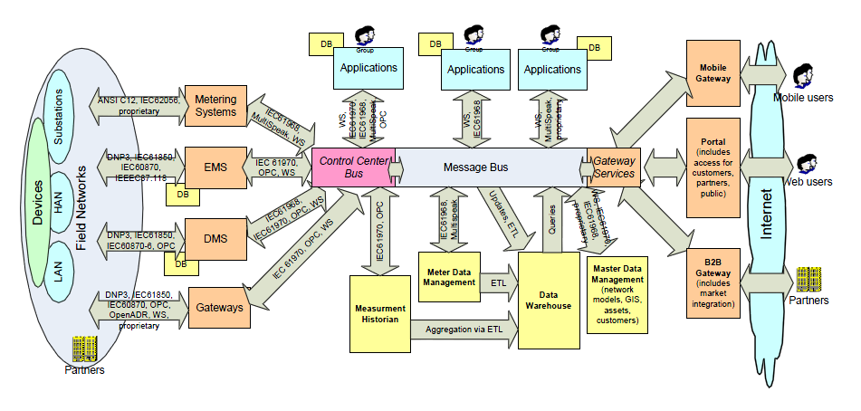
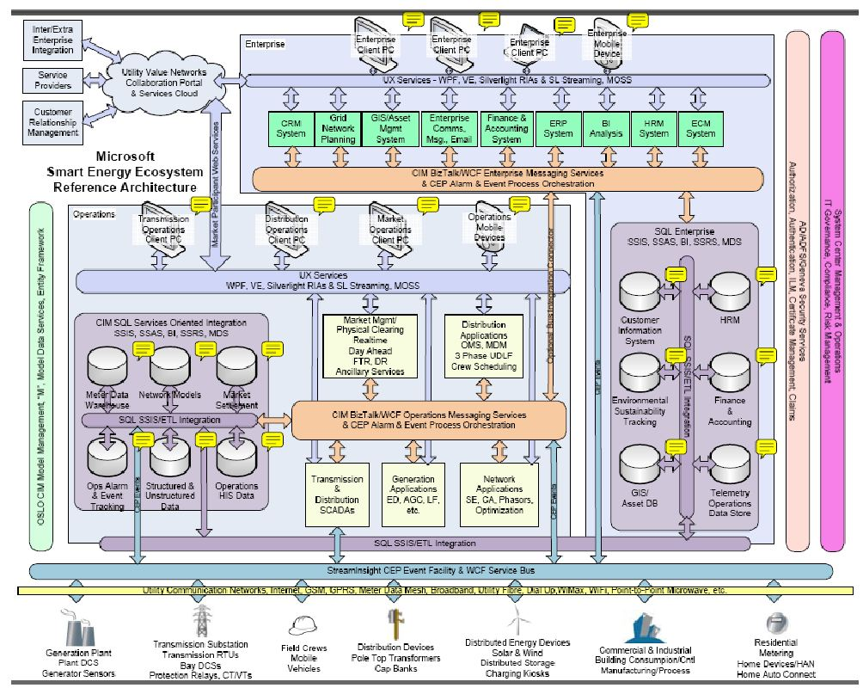
Microsoft SERA
Reference architecture to establish a vision that maximizes Microsoft’s value to customers by articulating a clear vision for the smart energy ecosystem
Describes the Microsoft and partner technologies to realize that vision

Slide 9
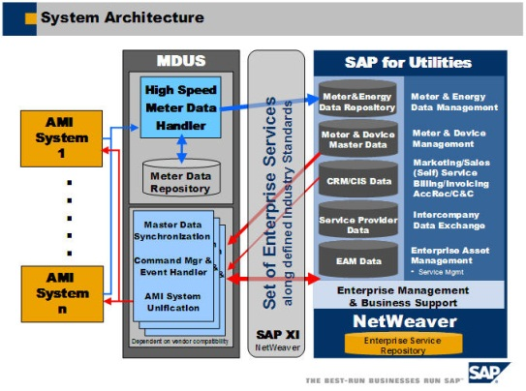
SAP Lighthouse Council - MDUS
SAP and participating utility companies formed the SAP AMI Lighthouse Council to address AMI from the back office to the meter, with the objective of integrating the SAP for Utilities solution to market-leading AMI Systems

Slide 10
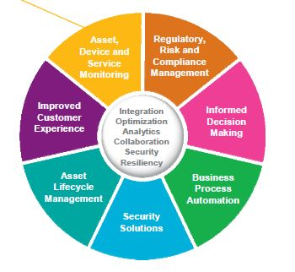
IBM SAFE
The IBM Solution Architecture for Energy and Utilities (SAFE) Framework supports a smarter way of performing business operations through integrated systems and analytics to streamline and accelerate company performance
Software platform built on IBM’s service-oriented architecture (SOA) and leveraging open industry standards to integrate across business applications and systems
Designed to provide network visibility and control, process automation and business collaboration for solutions across the energy value chain

Slide 11
Standards Quadrants
IEC
IEEE
NIST SGIP
GWAC
OpenSpeak, DNP3, OPC
OASIS Open SGRM
Open
OpenHAN, OpenADR
EPRI Intelligrid
ZigBee
Neutrality
ZWave
VendorFocus
Microsoft SERA
SAP Lighthouse
IBM SAFE
Interoperability
Architecture
Focus

Slide 12
Open Smart Grid Reference Model
1. Fill Industry Gaps:
Reference model for utilities and vendors that allows different standards and efforts
Open, but relevant for vendor solution definition and positioning
Sufficiently high-level for enterprise architecture planning
Sufficiently detailed to guide implementation decisions, technology selection
Focus on definition, not detailed object models, commands, interoperability
Not competing with standards efforts
2. Support Solution Process Flow:
Future state of utility
Current State
Business Need
Value-Complexity Prioritization
Roadmap

Slide 13
Agenda
Morning Briefing: Meter Data Management
Introduction
A Primer on Meter Data Management Systems
Key Planning Considerations
MDMS Market Landscape
MDM Case Studies
Best Practices
Afternoon Workshop:
Goals
Top Concerns
Action Plan
Next Steps

