Slide 1

Addressing the New Complexities in Key Management Interoperability
KMIP V.Next
www.oasis-open.org
Notes:
Bob:
Hello and welcome to this webinar on the OASIS Key Management Interoperability Protocol., or KMIP. My name is Bob Griffin, Chief Security Architect for RSA, the Security Division of EMC and co-chair of the KMIP technical committee.

Slide 2





Presenters
Tony Cox - Business Development Manager, Cryptsoft
John Leiseboer - CTO, Quintessence Labs
Robert Griffin - Chief Security Architect, RSA/EMC
Nathan Turajski - Senior Product Manager, Thales
e-Security
Saikat Saha - Senior Product Manager, Data Encryption & Control, SafeNet
Notes:
Bob
During this presentation, I’ll be joined by two of my colleagues from the KMIP: Technical Committee:
Tony Cox, Business Development Manager for Cryptsoft
John Leiseboer, the CTO of Quintessence Labs
Tony and John will introduce themselves in more depth as we get into the webinar.

Slide 3
Agenda
What KMIP has accomplished
New challenges in key management
Addressing the challenges
Notes:
Bob
We’ll be discussing three topics in this webinar:
First, what has KMIP accomplished so far in the three years since we convened the KMIP technical committee. Tony will be speaking to this topic
Second, what are the new challenges in key management that we believe need to be addressed in a standard such as KMIP. John will be speaking to this topic.
Finally, given those accomplishments and challenges, what’s next for KMIP? I’ll be returning to speak about this topic and to wrap up the webinar.
With that, I’ll turn over the microphone to Tony.

Slide 4
KMIP V1.0 / V1.1
Notes:
Tony
Hi – I’m Tony, etc.
As Bob indicated, we’ll start by looking at what KMIP has accomplished in the three years since the committee was founded in 2009. We completed the V1.0 standard in 2010 and have just completed our 1.1 version. What’s included in KMIP to date? What problems is it solving?

Slide 5
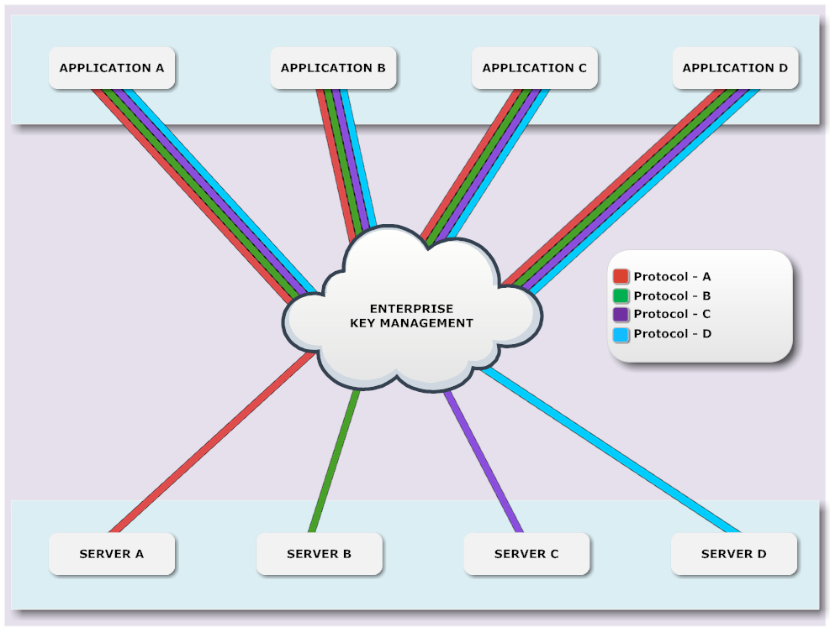
Prior to KMIP each application had to support each vendor protocol
Notes:
Tony
We began the development of KMIP in response to two major problems. The first of these was the lack of interoperability across key management environments. Say you had an encrypting tape drive from a particular vendor. Could that tape drive talk to any key manager available in the market? Typically not. Most cryptographic applications, like encrypted storage, or application encryption environments or database encryption products had their own key management environments and talked only to those environments. This meant that an enterprise that was using encryption or other cryptographic capabilities like digital certificates would likely have several different key managers, resulting in increased operational costs, training costs and infrastructure costs.

Slide 6
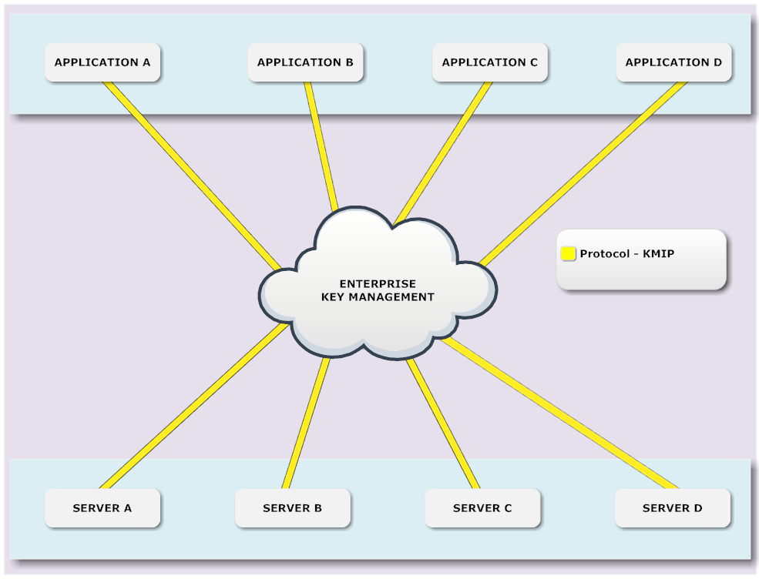
With KMIP each application only requires support for one protocol
Notes:
Tony
This was the first problem that we addressed with KMIP. That is, we wanted to create a single protocol that different cryptographic environments– tape drives from different vendors, application encryption sdks from different vendors, database encryption applications from different vendors, and so on – could use to talk to any key manager that supported the protocol. One vendor’s tape drive should be able to request keys from another vendor’s key manager for purposes of encryption and decryption. An application using one vendor’s key management library should be able to talk to another key manager if an enterprise was already using that key manager for tape encryption. A particular database encryption environment should be able to use KMIP to talk to an another vendor’s key manager if a business was already using that key manager, and so on.
The goal was to establish a robust protocol that addressed the common requirements for interaction between cryptographic environments and key managers, reducing the operational, training and infrastructure costs for key management in the enterprise.

Slide 7
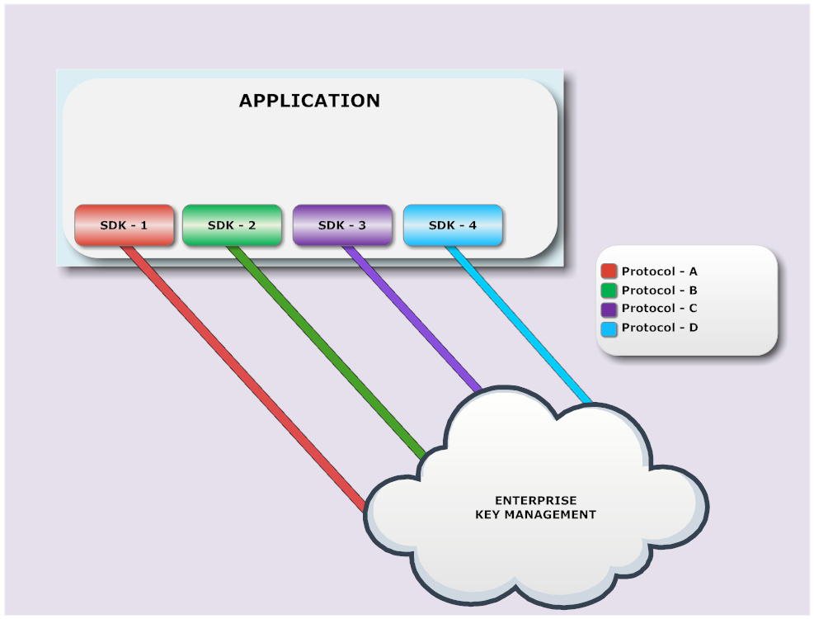
Prior to KMIP each application had to integrate each vendor SDK
Notes:
Tony
The second problem that we wanted to solve with KMIP was to reduce operational, infrastructure and implementation costs by enabling individual cryptographic software development kits to talk to multiple key managers. This would again reduce the key management costs and risk for enterprises, such as in terms of the cost of developing and maintaining expertise in different SDKs.

Slide 8
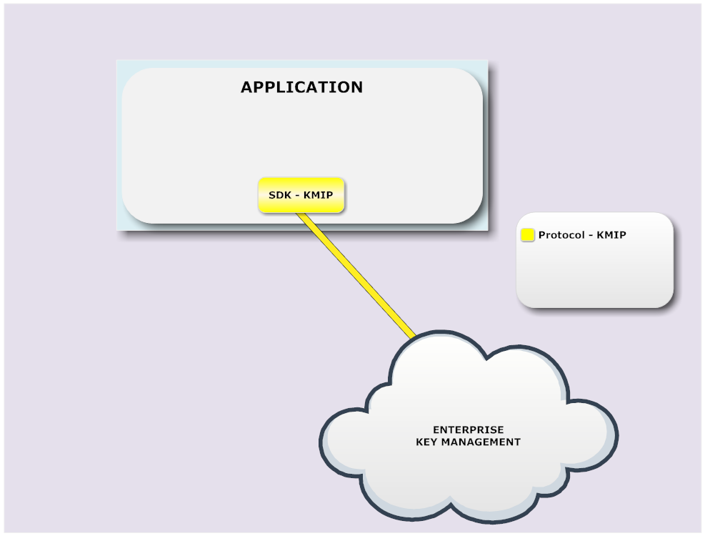
With KMIP each application only requires one vendor SDK integration
Notes:
Tony
With KMIP, an SDK that uses KMIP can talk to multiple key managers, as long as those key managers support the KMIP protocol. Developers could learn one set of tools, regardless of what key manager an enterprise might use. Moreover, changes in the key management strategy could be put in place without having to retrofit applications to talk to a different key manager.

Slide 9
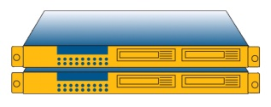

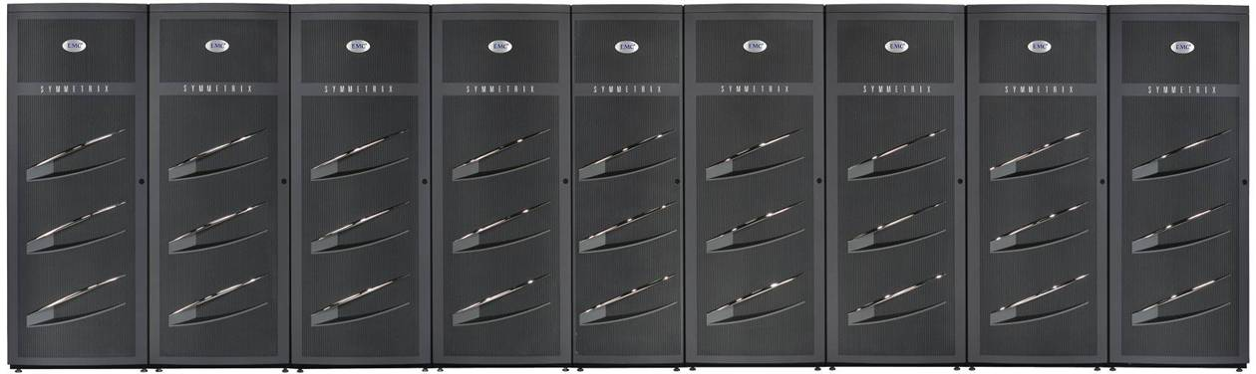

KMIP Request / Response Model
Enterprise Key Manager
Response Header
Symmetric Key
Unique Identifier
Key Value
Request Header
Get
Unique Identifier
Name: XYZ
SSN: 1234567890
Acct No: 45YT-658
Status: Gold
@!$%!%!%!%%^&
*&^%$#&%$#$%*!^
@*%$*^^^^%$@*)
%#*@(*$%%%%#@
Unencrypted data
Encrypted data
Encrypting Storage
Host
Notes:
Tony -
The first version of KMIP established the most critical elements of a single protocol that could address these critical issues confronting enterprises.
Within the areas where the need for an interoperable protocol was most strongly voiced by enterprises –especially data encryption in environments such as tape drives, storage arrays, applications and databases – most interactions were based on requests initiated in the client environment and responded to by a key manager. For example:
Get a new encryption key.
- Get the key corresponding to this identifier
- Store this key that a device has created
These and other operations initiated by the client were the core of most key management systems and led us to design a request/response protocol in which most operations occurred as a result of a client request.
We established a common format for messages that enabled clients and servers to express the objects, attributes and operations that were requested. As in the example shown here, a request for a specific key might include the unique identifier for the key; the response would include the value for the key, which could then be used by the cryptographic environment for encryption or decryption. The request can also return other information about the key, such as that it is s a symmetric key.

Slide 10
KMIP defines a set of Operations that apply to Managed Objects that consist of Attributes and possibly cryptographic material
Protocol Operations
Managed Objects
Object Attributes
Create
Create Key Pair
Register
Re-key
Re-key Key Pair
Derive Key
Certify
Re-certify
Locate
Check
Get
Get Attributes
Get Attribute List
Add Attribute
Modify Attribute
Delete Attribute
Obtain Lease
Get Usage Allocation
Activate
Revoke
Destroy
Archive
Recover
Validate
Query
Discover Version
Cancel
Poll
Notify
Put
Unique Identifier
Name
Object Type
Cryptographic Algorithm
Cryptographic Length
Cryptographic Parameters
Cryptographic Domain Parameters
Certificate Type
Certificate Length
X.509 Certificate Identifier
X.509 Certificate Subject
X.509 Certificate Issuer
Certificate Identifier
Certificate Subject
Certificate Issuer
Digital Signature Algorithm
Digest
Operation Policy Name
Cryptographic Usage Mask
Lease Time
Usage Limits
State
Initial Date
Activation Date
Process Start Date
Protect Stop Date
Deactivation Date
Destroy Date
Compromise Occurrence Date
Compromise Date
Revocation Reason
Archive Date
Object Group
Fresh
Link
Application Specific Information
Contact Information
Last Change Date
Custom Attribute
Certificate
Symmetric Key
Public Key
Private Key
Split Key
Template
Policy Template
Secret Data
Opaque Object
Key Block (for keys)
or
Value (for certificates)
Notes:
Tony
KMIP defines a set of objects, operations and attributes that can used within this request/response model. The objects include symmetric keys, asymmetric keys and certificates. KMIP also provides support for templates that can be used to establish default attribute values when creating an object.
Various attributes are available for these objects, such as a unique identifier for the object, the state of the object in terms of the key lifecycle, time-related attributes such as creation date and so on. Some of these attributes, like unique id, are common to all objects. Others, like certificate issuer, are unique to one or more objects.
These objects can be used in a variety of operations. One can get both symmetric and asymmetric keys, for example. There are also operations that are specific to certain kinds of objects, such as certify operations used with digital certificates.
Although most operations follow the request/response model, KMIP also defines two operations, notify and push, that can be initiated by the server rather than the client. These serve special purposes, such as enabling servers to ensure that a client receives notification when a cryptographic object has been compromised.

Slide 11
Transport-Level Encoding
Key Client
Key Server
API
API
Internal representation
Internal representation
KMIP Encode
KMIP Decode
Tag
Type
Len
Value
Tag
Type
Len
Value
…
KMIP Encode
KMIP Decode
…
Value
Len
Type
Tag
Value
Len
Type
Tag
KMIP TTLV encoding
Transport
Transport
Notes:
Tony
The request and response messages are encoded at the transport level. Each object, operation and attribute is expressed by a tag identifying that object, operation or attribute. The tag is followed by an identifier of the data type for the value that is being provided. The type is followed by the length and value of that object, attribute or operation. Expressing the message in TTLV enables the protocol to be used in the broadest possible range of environments. Other expressions of the protocol such as using XML or JSON, though not yet specified for the KMIP standard, can be used at higher levels in the stack, making it easier for different environments to interact with the protocol.

Slide 12
Message Encoding
In a TTLV-encoded message, Attributes are identified either by tag value or by their name, depending on the context:
  When the operation lists the attribute name among the objects part of the request/response (such as Unique Identifier), its tag is used in the encoded message
  When the operation does not list the attribute name explicitly, but instead includes Template-Attribute (such as in the Create operation) or Attribute (such as in Add Attribute) objects as part of the request/response, its name is used in the encoded message
Get
Unique identifier
…
operation
04
Unique Identifier
4
0000000A
06
24
1f165d65-cbbd-4bd6-9867-80e0b390acf9
tag
type
length
value
tag
type
length
value
Notes:
Tony
KMIP allows significant flexibility in expressing messages, such as in being able to represent attributes either by name or by tag value, depending on the context. This example shows how the request for a key, using the Get operation, could be encoded. Alternatively, the name rather than the unique i-d can be used when attributes of the object are being modified.

Slide 13

Authentication
Authentication is external to the protocol
All servers should support at least
  TLS V1.0
Authentication message field contains the Credential Base Object
  Client or server certificate in the case of TLS
Host
Enterprise Key Manager
SSL/TLS
@!$%!%!%!%%^&
*&^%$#&%$#$%*!^
@*%$*^^^^%$@*)
%#*@(*$%%%%#@
@!$%!%!%!%%^&
*&^%$#&%$#$%*!^
@*%$*^^^^%$@*)
%#*@(*$%%%%#@
Identity certificate
Identity certificate
Notes:
Tony
KMIP takes advantage of secure channels established using TLS to ensure the confidentiality and integrity of the request and response messages. Interoperability is encouraged by requiring that all implementations claiming conformance have to support TLS 1.0, at a minimum. Later versions of TLS can be optionally supported and are routinely exercised in KMIP interoperability tests and events.

Slide 14






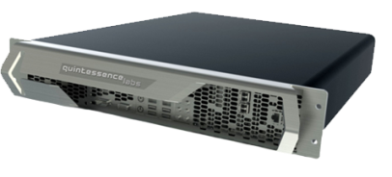

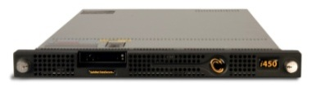



KMIP Interop at RSAC 2012
2 x Server
Server
Server
Server
2 x Server
Interop Network
3 x Client
Client
Client
Client
3 x Client
Client
Notes:
Tony
One such interoperability event was held at the RSA Conference in San Francisco in February of this year. A similar event was held at RSA Conference the previous year and another such event is being planned for RSA Conference 2013.
The events, held in the OASIS booth in the conference exhibition hall, demonstrated interaction between clients and servers from different vendors, according to a well-defined set of tests that exercised a broad range of KMIP functionality. These events built on the substantial interop testing that is routinely performed as part of our work on the KMIP standard.

Slide 15
KMIP Test Cases
Provide examples of message exchanges for common key management requirements
  basic functionality (create, get, register, delete of sym. keys and templates)
  life-cycle support (key states)
  auditing and reporting
  key exchange
  asymmetric keys
  key roll-over
  archival
  vendor-specific message extensions
Details of the message composition and TTLV encoding
Notes:
Tony
The test cases that we exercised in this interoperability event are used extensively by members of the KMIP TC to validate the protocol and to ensure that different implementations of KMIP can indeed work together. The test cases exercise a broad range of functionality, representing common key management requirements such as creating and getting keys, changing key attributes, archiving keys and so on.
The Test Cases are expressed in a illustrative document that provides details of the messages and encoding, so that the different implementations can confirm that they are building the messages and interpreting the standard in compatible ways.

Slide 16
KMIP Profiles
Define what any implementation of the specification must adhere to in order to claim conformance to the specification
  Define the use of KMIP objects, attributes, operations, message elements and authentication methods within specific contexts of KMIP server and client interaction.
  Define a set of normative constraints for employing KMIP within a particular environment or context of use.
  Optionally, require the use of specific KMIP functionality or in other respects define the processing rules to be followed by profile actors.
Examples of KMIP profiles
  Secret data
  Symmetric key store
  Symmetric key foundry
Profiles are further qualified by authentication suite
  TLS V1.0 / V1.1
  TLS V1.2
16
Notes:
Tony -
Conformance to KMIP is expressed in terms of profiles, representing groupings of functionality that address real-life needs such as vaulting keys that are created within a storage environment. The profiles are expressed in a normative document that identifies the functionality to be used in implementing the profile. They also define the authentication that must be used with that profile to ensure message confidentiality and integrity.

Slide 17
KMIP Usage Guide
Provides detailed guidance on how to implement KMIP functionality, including such topics as:
  Key states and times
  Using KMIP templates
  Using vendor-specific extensions
  Using batch for multiple operations
  Canceling asynchronous operations
Notes:
Tony -
Finally, KMIP also has a Usage Guide, an illustrative document that provides detailed guidance on how to use the KMIP protocol. Information in the document includes guidance on the Notify and Put operations, explanation of the key states represented in KMIP attributes and operations, how to use KMIP templates, and many other topics.

Slide 18
New Challenges in Key Management
Notes:
Tony -
These accomplishments in KMIP V1.0 and V1.1 have created a robust and effective key management protocol that is already implemented in a number of products and achieving increasing acceptance through the industry. But there are new challenges in key management that KMIP has to respond to. I’ll turn the microphone over to my colleague John Leiseboer, who will discuss these new challenges.

Slide 19













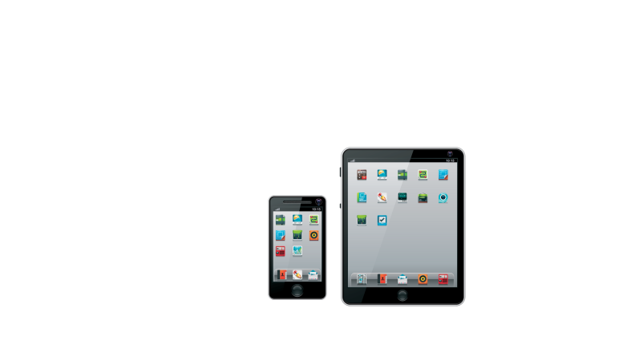


Business & IT are evolving rapidly…
Notes:
John -
In the past several years, we’ve seen tremendous changes in information technology. Mobile devices and virtualization have transformed the ways users interact with applications and how IT infrastructure is deployed and managed. Service-based approaches to application development have shifted developer interest towards new representations such as JSON. Big data has transformed business analytics. Cloud has offered new models for the rapid and cost-effective allocation of resources for corporate initiatives..
This transformation in computing is creating incredible new opportunities for collaboration, communication and innovation. This webinar is an example of those opportunities, bringing together speakers and attendees from around the world to share information about where we’re going with KMIP.
But this transformation also creating new vulnerabilities that cyber criminals, hacktivist groups and nation states have learned to exploit. Attackers are getting more sophisticated, combining multiple attack vectors with extensive research into the targets of their attacks.
Cryptography offers substantial capabilities in addressing the threats and supporting these new capabilities. For example, data encryption is already being used extensively for protection of information that is entrusted to the public cloud. But effective use of cryptography requires careful attention to keys. How have the changes in business and IT affected key management? And what do though changes imply for the future of KMIP in particular?

Slide 20








Cloud Key Management
Enterprise
Administrators
Application
Users
CSP
Administrators
Enterprise App
App Data
Key Server
HSM
vSphere
Key DB
Enterprise IT
Cloud Service Provider
Notes:
John -
In deploying applications in private, public, community and hybrid clouds, there are lots of places where cryptography is already being used, from establishing secure channels to encrypting sensitive information to authenticating users and entities. But many of the implications for key management are still being explored. For example, there is increasing interest in having data encryption performed in applications that are deployed into cloud services, platforms and infrastructure. But many enterprises want to keep key management inside the enterprise.
In this hybrid cloud model, keys have to distributed from the enterprise to the cloud service provider environment, either directly to an application performing encryption or to a key manager dedicated to that tenant. This approach has the benefit of enabling all encryption to take place within the contracted resources at the cloud service provider. It has the drawback of requiring keys to be transported outside the enterprise environment, increasing their vulnerability to attack. For example, if the keys are entrusted temporarily to an application in the cloud for purposes of encryption or decryption, how does the enterprise know that keys are not inadvertently exposed as they move across the CSP infrastructure?
This raises the question of what this use of key management for the cloud implies for KMIP. Are the current objects, operations and attributes sufficient to handle the use cases for key management for the cloud, across all of the deployment models that may be used?

Slide 21









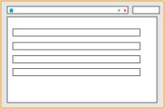
Complex Enterprise Security Requirements
HSM With Multiple Partitions
Application + HSM with EKM Client
Database + HSM with EKM Client
Backup HSM and Key Archive
EKM
Centrally see all keys created and used by HSM
Stores and manages key attributes
Centralized audit for compliance
Initialization
Activation
EKM
EKM Web Browser
Audit Log
Notes:
John
Even within the enterprise, security requirements have become more complex. For example, virtualization enables the movement of workloads across a geographically dispersed infrastructure, in order to make the most efficient possible use of resources. What does that mean for the relationship between roots of trust, such as those provided by hardware security modules, and the applications and key managers that rely on that highly secure environment?
In many cases, HSMs need to remain in physically protected and highly controlled environments, while the key manager and cryptographic applications can move more freely across a virtual infrastructure. In that case, how does the enterprise ensure the secure distribution of keys, their use only in authenticated and authorized applications, and restrictions on their movement into particular geographical locations or particular instantiations of the infrastructure?
Once again, are there new objects, operations and attributes needed in KMIP to address these new complexities in enterprise security requirements?

Slide 22
PGP Key Management
Notes:
John
There are many important cryptographic environments where key management is crucial that have not yet been addressed by KMIP. For example, there are objects and relationships that are unique to a PGP environment, both as a standard and as a vendor product, that are not currently represented in KMIP.
For example, PGP links together multiple keys pertaining to a single user, in a way that KMIP doesn’t currently represent. Similarly, PGP has concepts such as the Additional Decryption Key, or ADK, also something not directly represented in KMIP.
How should the protocol represent the unique capabilities of PGP and other environments? To what extent can those unique requirements be represented in the existing protocol, adapting or generalizing capabilities that are already there? To what extent does effective support for those environments require new objects, attributes and operations?

Slide 23
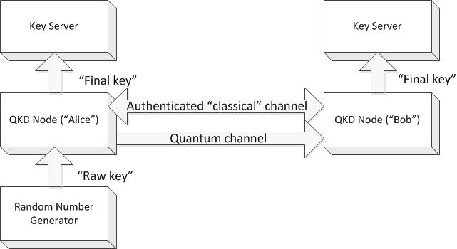
Quantum Key Distribution
QKD
Raw key: True random
Final key: Secure, secret, replicated, synchronised true random
Notes:
John -
There are also new cryptographic technologies that are transforming such critical areas as trust establishment. Quantum key distribution, for example, is already being used in commercial and government solutions, taking advantage of the properties of light transmission across optical fiber to detect and respond to eavesdropping and other attacks. Once trust is established, symmetric keys used for data encryption, for example, can then be distributed across that trusted channel just as they are with SSL/TLS.
KMIP is already being used as the key management protocol layered on trust establishment across a quantum channel. What additions or changes to KMIP are needed to strengthen support for this and other new technologies? To what extent can the streaming model in technologies such as quantum key distribution be applied to other environments, such as secure video streaming? To what extent should these broader requirements be supported in KMIP?

Slide 24






Changes in the Threat Landscape
Petty criminals
Organized crime
Criminals
Organized, sophisticated supply chains (PII, financial services, retail)
Unsophisticated
Nation state actors
PII, government, defense industrial base, IP rich organizations
Anti-establishment vigilantes
Terrorists
Non-state actors
PII, Government,
critical infrastructure
“Hacktivists”
Targets of opportunity
Notes:
John -
In all these areas, opportunities in new technologies, new business models and new development capabilities have to be addressed in the context of ever more aggressive and sophisticated attackers. The kinds of attackers who are targeting businesses, industries and the academic community have changed, including not only cybercriminals, but also nation states and non-state actors such as terrorists and hacktivists.
These attackers are using new as well as established models for their attacks. For example, advanced attacks combine social engineering, zero-day vulnerabilities and in-depth investigation of targets in order to extract valuable information and intellectual property from their victims.
The attackers can have many reasons for their attacks, including not only financial gain but also disruption of business or critical infrastructure. Cryptographic keys can be targeted by attackers for many reasons, including as part of a larger strategy to get to information that has been secured by encryption.
These changes in the profiles of attackers, in the kinds of attacks, and in the targets of attacks have a number of implications for KMIP. Are the attack models that KMIP must address well enough understood? Are there new capabilities for integrity, confidentiality and availability that are needed in KMIP, in the light of the new threat landscape?

Slide 25
Addressing the New Challenges in Key Management
Notes:
John -
Given these challenges, what needs to be done as we begin our work on the next version of KMIP? I’ll hand the microphone back to Bob Griffin, who’ll discuss the direction that we have been setting for KMIP V.next, in the light of these and other challenges.

Slide 26
KMIP V.Next
Use Cases
  Define user stories and sequence for both existing and new areas of functionality
Enhanced Protocol
  Provided objects, attributes and/or operations as needed for in-scope use cases
Testing Program
  Establish formal and on-going program for KMIP interoperability testing
Test Cases
  Enhanced suite of test cases to support interoperability testing as well as protocol validation
Profiles
  Establish simpler model for conformance, supported by profile-specific test cases
Notes:
Bob
In our face-to-face meeting in February of this year, the KMIP technical committee decided that we needed to be more thorough in developing and documenting the use cases that we want to address in the standard. We had certainly had use cases in mind when we defined the initial versions of KMIP, such as the tape encryption, storage array encryption, application encryption and database encryption examples that Tony described. But in order to address the new complexities that John have discussed, we had to move into new territory where the key management requirements were still emerging. Defining use cases for cloud, HSMs, PGP, key administration, client registration, server-to-server interactions and streaming key material such as in QKD would give us a handle on what made sense for KMIP to take on. Addressing these new areas might mean extending the charter for the technical committee, and use cases would give us a good way to determine whether this re-chartering makes sense.
In our face-to-face meeting just a few weeks ago, we took advantage of the use cases effort, led by Mike Allen of Symantec and Denis Pochuev of Safenet, to define the direction and scope for KMIP V.Next. We’re still working on exactly what changes need to be made to object, attributes and objects, to authentication suites and message elements. But the use cases have helped us to focus our work and will also provide valuable context for those interested in implementing KMIP. I’ll discuss several of the areas that John described in terms of what we see as the implications for KMIP that we should address in V.Next.
We have also identified a number of work areas that go beyond enhancements to the protocol. One of the most important is progress in developing a program to enable validation of KMIP client implementations against KMIP-enabled key manager products. We’re still working on the details of this program, but hope to announce it over the next month or two.
We will be enhancing our test cases to support this program, as well as continuing the critical value that the test cases have validating KMIP functionality and ensuring consistent interpretation of the standard.
We’ll also be revising the profiles to bring them closer to the real-world use of KMIP, so that both client and server vendors can more easily and clearly define what KMIP functionality they have implemented and tested for interoperability.

Slide 27
Use Cases for Hybrid Cloud
Enterprise
Administrators
Application
Users
CSP
Administrators
Use Cases
Tenant administration
Key migration
Policy distribution
Implications
Tenant granularity
Key export/import
Policy distribution
Client registration
Enterprise App
Key Server
App Data
HSM
vSphere
Key DB
Enterprise IT
Cloud Service Provider
Notes:
Bob
When we looked in detail at the use cases for key management for the hybrid cloud that John described, we found that there were several very different kinds of issues for which KMIP was relevant. There are a number of use cases related to tenant administration of the key management related capabilities in a cloud deployment; for example, how do applications in the cloud register with the key manager in the enterprise, in this model?
There are a number of use cases related to the movement of keys, not only in terms of individual key requests from registered clients, but also for such situations as moving larger numbers of keys from the enterprise into a cloud environment to reduce the number of key requests. There are also use cases related to the coordination or propagation of policy between the enterprise and the cloud, such as defining the lifetime for keys entrusted to the cloud.
The use cases uncovered several implications for KMIP, some of which we anticipate addressing in V.Next, others of which will likely be deferred to further investigation. For example, the support for multiple tenants in a cloud service provider implies visibility of the tenant, as well as the larger CSP environment, in key-related interactions.
Similarly, effective registration processes for clients need to be defined, and perhaps similarly supported by new mechanisms for distinguishing tenants within a cloud service provider. On the other hand, our discussion of the use cases for the cloud environment indicated that the bulk export/import of keys and the distribution of policy, particularly as a first-class object, are probably topics we can defer to future work rather than addressing in KMIP V.Next.

Slide 28
Use Cases for Hardware Security Modules
HSM
Administrators
Application
Users
Application
Administrators
Use Case
Trust establishment
Protection of keys in transit
HSM
Divisional App
Key Server
App Data
Key Server
vSphere
Implications
Devices types
Vendor extensions
Key DB
Key DB
Enterprise IT
Divisional Applications
Notes:
Bob
The HSM use cases led us to consider critical issues in trust establishment and protection of keys in transit. In fact, we introduced these use cases into the recent key management workshop at the US National Institute for Standards and Technology, or NIST, in order to talk about the key management issues in interactions across security domains.
The use cases led us into investigation of implications such as greater visibility in the protocol into the devices participating in request/response exchanges. The ability to specify whether a key is in a protected device such as an HSM, for example, is likely needed in KMIP in order to address the complexities in the enterprise environment. Understanding what should be implemented as vendor extensions and what needs to be expressed directly in KMIP objects, attributes and operations is also critical in making sure that KMIP supports effective interoperability in the complexities of the virtualized enterprise.

Slide 29
Use Cases for PGP Keys
Use Cases
User registration
Key lookup
Key signing
Trust validation
Implications
Key structures
User identifiers
Signature sets
Notes:
Bob
The PGP use cases defined the critical interactions between a PGP infrastructure, users and applications that will affect PGP support in KMIP. For example, core use cases like key lookup are very similar to comparable use cases in cloud and storage. But special PGP capabilities like Additional Decryption Keys are not directly represented in KMIP currently; similar, the link relationships among PGP keys are not directly represented and probably require at a minimum enhancements to the link attributes that are currently defined for KMIP objects.
In addition to defining the essential enhancements to KMIP that would support interoperability for PGP, we’ll also be creating usage information to guide developers in applying KMIP to PGP; that kind of information is important not only in helping developers take advantage of KMIP, but also in improving the opportunity for interoperability by ensuring consistent interpretations of KMIP functionality.

Slide 30
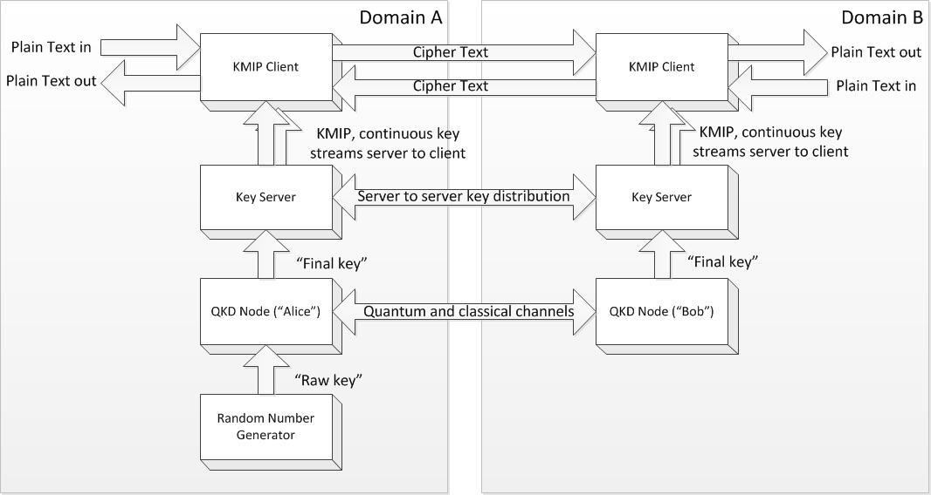
Use Cases for Quantum Key Distribution
Use Case
QKD trust establishment
Implications
Stream objects, operations and attributes
Server: Replicated, synchronised keys across domain boundaries
Client: KMIP operations with key server in same domain
Notes:
Bob
The use cases for support of Quantum Key Distribution provided detailed understanding of how that technology can be used in trust establishment, with KMIP then taking advantage of that trust to exchange symmetric keys or other objects. Like the HSM use cases, we also used the QKD use cases in the NIST key management workshop to explore cross-domain key interactions. But equally important, the QKD use cases demonstrated important implications for KMIP generally in terms of support for stream objects, operations and attributes that could be applied in other areas such as secure video streaming.

Slide 31
KMIP Interoperability Program
KMIP conformance testing program
  Design, implementation, management, measurement, and reporting
Test Specification Mentoring and Review
  Revision tracking
  Test environment architecture
  Test case specifics
Test Harness Development Mentoring and Review
  Revision tracking
  Delivery mechanisms
  Peer review and sign-off
  Website for access of test results
Notes:
Bob
As you can see, from this brief discussion of the use cases and their implications, KMIP V.Next will be taking full advantage of the existing capabilities defined in the protocol in order to support significant new areas in which key management interoperability is important. There will undoubtedly be enhancements to objects, attributes and operations. But based on the work we have done so far, we expect those to be relatively small enhancements, rather than extensive revisions to the protocol. It does appear to us, however, that we can best address these new areas by broadening the charter of the technical committee so that we can readily address questions such as client registration, server-to-server interactions and representations of the protocol not only in tag-type-length-value but also in more readily accessible forms such as XML and/or JSON.
Equally important for KMIP V.Next is the definition of use cases and the specification of enhancements to the protocol will be putting in place a program in support of interoperability. We see this program as including three parts. First, the design, implementation, management, measurement and reporting of the testing activity itself. Second, activities in support of the specification of the tests used in the program, including mentoring the vendors taking advantage of the program to validate clients or servers. Third, the on-going development and support of the test harness, including mechanism for reporting results.
We hope to announce the details of this testing capability soon and look forward to the value it will bring in ensuring the KMIP really does achieve the key management interoperability that is our goal.

Slide 32


New members welcome
interoperability
DRIVE KMIP
adoption
Tap into the KMIP brain trust
Contribute to KMIP test cases and profiles
Be heard
a) business reqs
b) use cases
You belong here
Grow global markets:
bigger pie = BIGGER SLICE
join@oasis-open.org
Notes:
Bob
The OASIS KMIP technical committee is a vibrant and energetic group of individuals from across industry, academia and government, dedicated to the addressing the issues in key management interoperability that we have described. You don’t need to be a member of the KMIP TC to take advantage of KMIP. But being a member of the committee gives you the opportunity to ensure that it is addressing the most critical issues and that is being adopted widely and effectively.
We hope you will consider joining us in developing and supporting KMIP, in whatever way makes most sense for you.

Slide 33
Thank You!
https://www.oasis-open.org
kmip-chair@lists.oasis-open.org
Notes:
Bob
You can find more information on our public page, at the URL shown here. Or don’t hesitate to contact me directly; you’ll find contact information for the TC and the co-chairs on this same web site.
Thanks very much for joining us in this webinar. We look forward to seeing you in KMIP!

