Slide 1
KMIP - Key Management Interoperability Protocol
Paul Meadowcroft
Thales e-Security

Slide 2
Agenda
  Key management problem
  Role of encryption and key management
  KMIP - Key Management Interoperability Protocol
  KMIP demo results
  Benefits of Enterprise Key Management

Slide 3
The Key Management Problem
That’s where we were back in 2008
  Big banks and governments use cryptography widely, due to necessity and compliance legislation, to protect assets and communications
  Cryptography turns a data management problem into a key management problem
  Only a small fraction (< 5%) of keys will be managed throughout their lifecycle
  The skills to manage them are rare and expensive; there are only piecemeal solutions for different classes of devices
  The most mature organisations are moving to address the risks associated with unmanaged keys, and the costs associated with manual processes, via an automated key management system

Slide 4
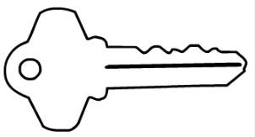
Encryption
Plain text
Cipher text
Encrypt - Decrypt
Open data
Closed data
The security model is underpinned by the secrecy of the decryption key
Notes:
Encryption is the same wherever it is done
The process is not the basis of security – needs to be implemented correctly but isn’t secret or user specific

Slide 5
Key Management Lifecycle
Generate
  High Assurance Key Management
  Keys need to be kept secret
  Keys need to be available
  Key management policies need to be enforced
  Key management processes need to be audited
Destroy
Register
Store
Back up
Recover
Suspend
Distribute/Install
Encryption
Revoke
Rotate
Key Management Lifecycle
Notes:
While encryption is the way to protect data – Key Management emerges as a critical control point
Strong argument that enterprise consumers should always keep this in-house
Accountability creates need for high assurance

Slide 6

10 crypto development “standards of due care”
  Know exactly where your keys are and who and what systems can access them at all times
  Control access to cryptographic functions and systems using strong authentication
  Know the origin and quality of your keys
  Implement dual control with strong separation of duties for all administrative operations
  Never allow anyone to come into possession of the full plain text of a private or secret key
  Ensure each key is only used for one purpose
  Formalize a plan to rotate, refresh, retain and destroy keys
  Only use globally accepted and proven algorithms and key lengths
  Adopt independently certified products wherever possible
  Ensure your keys are securely backed-up and available to your redundant systems

Slide 7
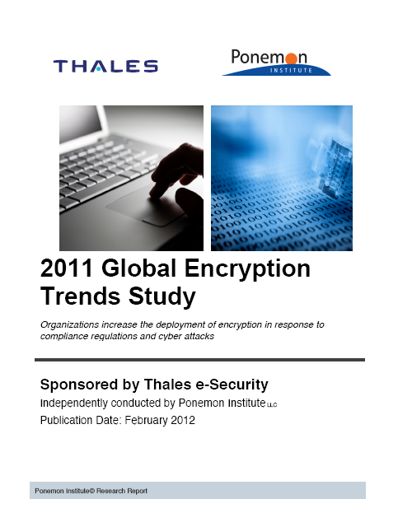
Why do we need encryption?
Top three reasons why organisations encrypt sensitive or confidential information
  To protect their company’s brand or reputational damage resulting from a data breach
  To lessen the impact of data breaches
  To comply with privacy or data security regulations and requirements
*Ponemon Institute report: 2011 Global Encryption Trends Study – Published February 2012

Slide 8

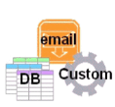










Challenges: Too Many Silos
Key
Manager
Key
Manager
Key
Manager
Key
Manager
Key
Manager
Key
Manager
Key
Manager
Key
Manager
P1
P2
P3
P4
P5
P6
P7
P8
Smart Grid
End User
Applications
Cloud
Applications
File & Host
Network
Fabric
Appliances
Storage Systems
Fragmented approach = higher risk, operational overhead and complex auditing
Notes:
Every application has it’s own silo and usually has A key management option that comes with the application, device or system. Even in the diagram above some of the systems would be different key managers even within one silo (File vs. Database, Mobile vs. Laptops, etc…).
Information moves between silos and since the goal is end to end security keys must also be able to span silos
b. Encryption is increasingly embedded and therefore key management has to be externalised

Slide 9
What do we want from encryption?
Top three most important features of encryption technology solutions
  Automated management of encryption keys
  Encryption administered through one interface for all applications
  Encryption technologies that have been independently certified to security standards
*Ponemon Institute report: 2011 Global Encryption Trends Study – Published February 2012

Slide 10

Goal: Unified, Comprehensive Approach
Enterprise Key Management
K M I P
Smart Grid
End User
Applications
Cloud
Applications
File & Host
Network
Fabric
Appliances
Storage Systems
Policy and Keys are Managed by Data Management Tools in conjunction with Key Managers
Notes:
Enterprise Key Management service consists of multiple functions shared between multiple servers using a common protocol to communicate. This allows keys to move where they need to be to support the data they are protecting.
Administration of the KMS via whatever interface works best for the organization (Web UI, Stand Alone secure application, Terminal Console, etc…). There will most likely still be multiple consoles to access the key management servers but use of these consoles will usually only be if a system is being replaced, reconfigured or audited.
The final step to a fully automated lights out KMS solution is one that requires a specific protocol for administration services for security and data to provide policy back into the KMS for the data used and supported by a given application. This means that traditional security and data management tools will need to integrate into a KMS. Once this is accomplished Enterprise Key Management becomes a reality. This allows keys to be managed using the same lifecycle that the data has. When data is deprecated, devices are removed or data is no longer required for regulatory purposes, all keys used throughout the lifecycle can be disabled or destroyed at the same time the data or objects are removed from the application, device or security management tools.
There are many things that have to be taken into consideration over the long term for key management standards. In order to get to a common system with potentially multiple vendors managing different keys there is still three to five years of work by standards bodies to get to the final point.

Slide 11







The History of KMIP
Began as a private consortium over 4 years ago
  Thales, IBM, RSA and HP
Adopted as an official OASIS TC
  Version 1.0 ratified end 2010 - over 30 companies
  v1.1 targeted for 2012 – includes implementation aspects (“Profiles”)
  Now tracked by analysts with Enterprise Key Management category
KMIP Interoperability Demo During RSA Conference 2012
15-day Public Review for KMIP V1.1
  The public review starts 4 June 2012 and ends 19 June 2012
Notes:
Key points…
Thought leadership – Thales was one of the original “4 Horsemen” who founded this specification along with other industry leaders IBM, RSA and HP. We believe in the importance of standards and have the expertise to contribute towards requirements.
Endorsement – 8 companies made up the original technical committee, now over 30 companies
Doing it right – Some companies have announced support to build awareness, however, capabilities have fallen short. We are taking a qualitative approach towards introducing a best-of-breed solution.
Public visibility – We participated in the interop. demo during 2012 RSA Conference and proved to be ahead of solutions that were already shipping and claimed KMIP support. (See last slides.)
Market timing – Now is the time to think about an Enterprise Key Management strategy based on interoperable key management for consistent security and operational efficiency ( = simplify maintenance and compliance with mandates)

Slide 12
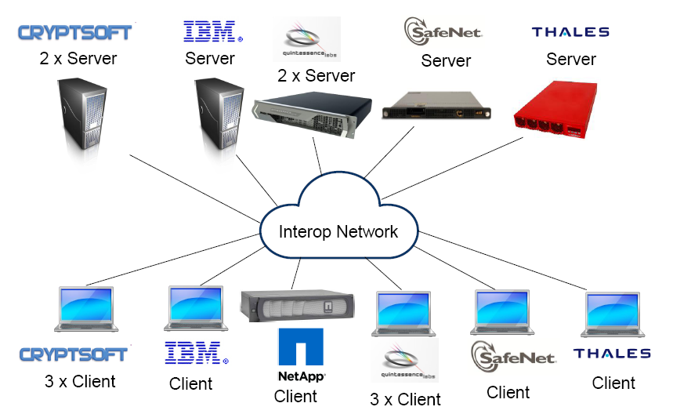
KMIP Interoperability Demo
*OASIS KMIP Interoperability Demonstration at RSA 2012 – 27 Feb to 2 Mar 2012
Notes:
Enhancements introduced in KMIP 1.1:
Defining new functionality in the protocol to improve interoperability, such as a Discover Versions operation and a Group object
Defining additional Use Cases for verifying and validating the new functionality
Providing additional information in the KMIP Usage Guide to assist in effective implementation of KMIP in key management clients and servers
d. Defining new profiles for establishing KMIP-compliant implementations
In particular the number of profiles has increased from 6 profiles to 42 profiles including those supporting asymmetric keys and certificates.

Slide 13
KMIP Servers – Use Cases Supported
*Final published reports: http://lists.oasis-open.org/archives/kmip/201205/msg00023.html
Notes:
Key takeaways:
Visual representation to cut to reality as of May 2012
Another interop is planned for June by OASIS
For current results, visit the OASIS website where this data is posted and updated

Slide 14
KMIP Clients – Use Cases Supported
*Final published reports: http://lists.oasis-open.org/archives/kmip/201205/msg00023.html
Notes:
KMIP clients remain “islands of trust” and are only KMIP compliant if they enforce the usage policy that was provided when a key was delivered via KMIP.
Secure / certified endpoints such as HSMs are still required!
Key managers also have the potential to become honey pots for attackers and therefore need to be appropriately hardened and certified.
It’s entirely possible for servers and clients to use KMIP as a transport for delivering opaque / proprietary secret objects so buyers need to look beyond the simple KMIP checkbox when determining whether a solution will really be interoperable.

Slide 15
Business Benefits of Enterprise Key Management
Automation
  Reduces risk of human errors; reduces process costs
Centralisation
  Avoids the 'multiple management console' scenario and allows establishment of a Key Management hierarchy
Accountability
  With strong authentication and audit establishes clear accountability for security processes
Agility
  Improves an organisation's ability to deploy data protection solutions more quickly

Slide 16
Thank you
The OASIS KMIP TC works to define a single, comprehensive protocol for communication between encryption systems and a broad range of new and legacy enterprise applications, including email, databases, and storage devices. By removing redundant, incompatible key management processes, KMIP will provide better data security while at the same time reducing expenditures on multiple products.
www.oasis-open.org

