Slide 1

OASIS PRIVACY MANAGEMENT REFERENCE MODEL
John Sabo, CA Technologies
Co-Chair, OASIS PMRM Technical Committee
J
EEMA
European e-identity Management Conference
Paris, 12-13 June 2012

Slide 2
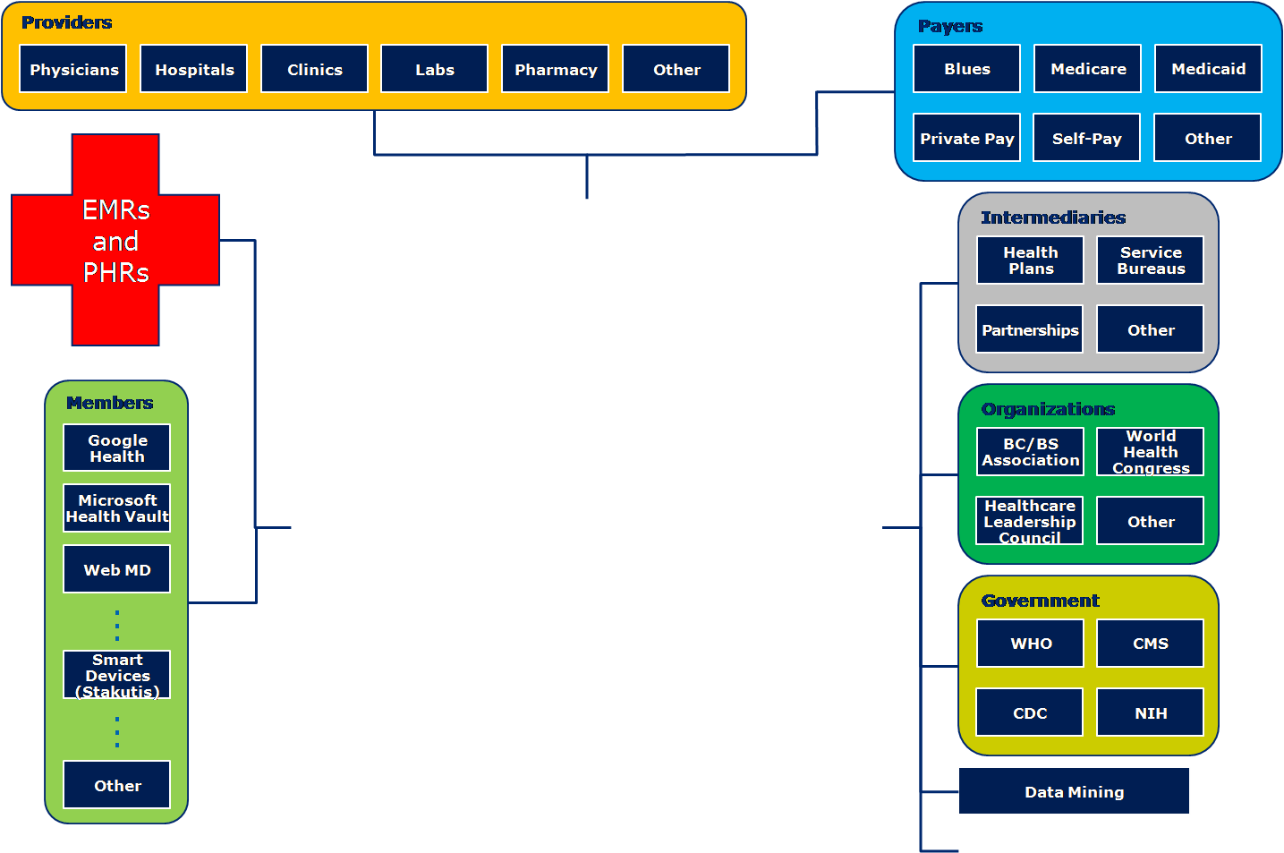
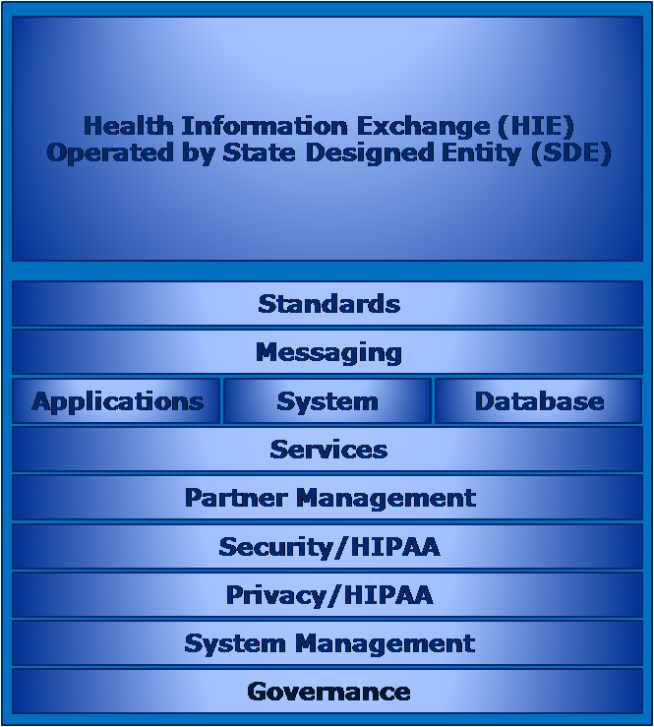
Policies and PI Across Domains
Business Intelligence
Health Information Exchange Functional and Roles Diagram

Slide 3
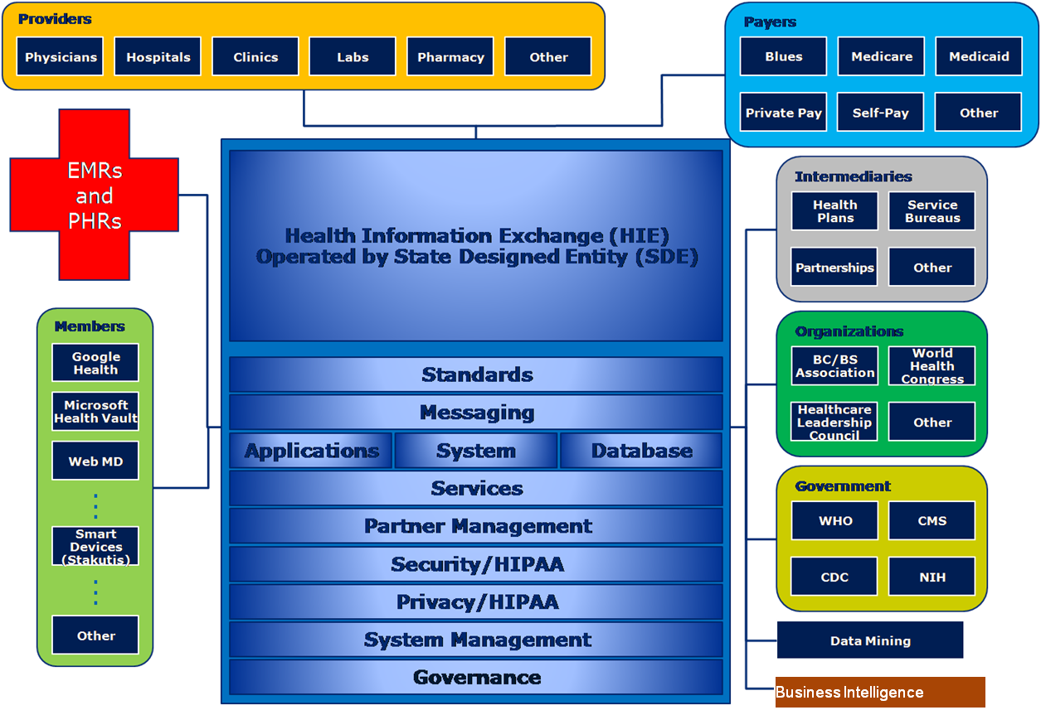
U.S. State of Maryland
U.S. State of Pennsylvania
State of Jalisco, Mexico
Province of Ontario, Canada

Slide 4
What is the Privacy Management Reference Model (PMRM)?
An analytic tool and methodology developed to:
  improve the ability to analyze use cases in which personal information is used, communicated, processed and stored
  understand and implement appropriate operational privacy management functionality and supporting mechanisms
  achieve compliance across policy and system boundaries
  support the stakeholders having an interest in the use case service or application
See www.oasis-open.org for TC information
http://docs.oasis-open.org/pmrm/PMRM/v1.0/csd01/PMRM-v1.0-csd01.pdf (Authoritative)
http://docs.oasis-open.org/pmrm/PMRM/v1.0/csd01/PMRM-v1.0-csd01.html
http://docs.oasis-open.org/pmrm/PMRM/v1.0/csd01/PMRM-v1.0-csd01.doc

Slide 5
Why is the PMRM Important?
Support for networked, interoperable services, applications and devices and the complexity of managing personal information across legal, regulatory and policy environments in interconnected domains
Applicability to privacy management and compliance in cloud computing, health IT, smart grid, social networking, federated identity and similarly complex environments
An organizing structure for exposing privacy requirements for specific business systems, organizing privacy management mechanisms, and improving systemic privacy management risk assessment
Support for “privacy by design” concepts
  PMRM is Not a static or a prescriptive model - implementers have flexibility in determining the level and granularity of analysis necessary for a particular use case

Slide 6
Three Major Components
A conceptual model of privacy management, including definitions of terms
A methodology
A set of operational services together with the inter-relationships among these three elements.

Slide 7
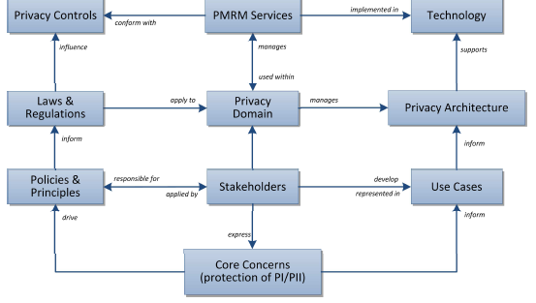
PMRM - Model

Slide 8
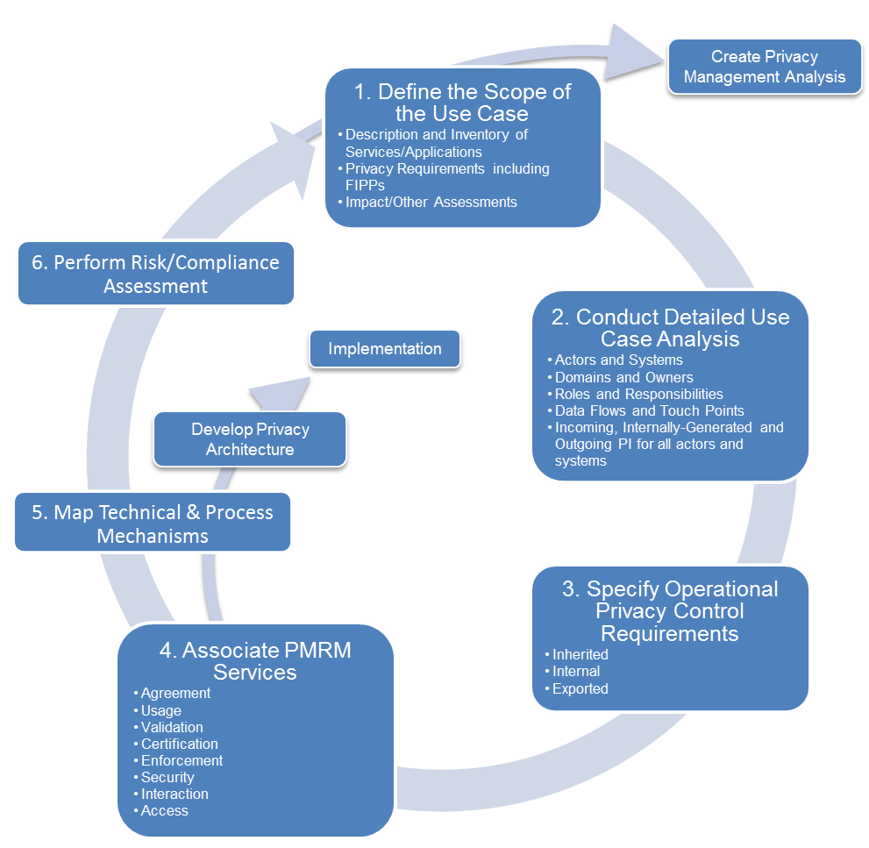
PMRM - Methodology

Slide 9
PMRM –Methodology
High Level Privacy Use Case Analysis
Services/Applications
Privacy Requirements
Detailed Privacy Use Case Analysis
Domains and Owners
Risks - Responsibilities
PI in Use Case Systems
System 1
System n
Incoming/Internally Generated/Outgoing
Impact/Other Assessments
Data Flows and Touch Points
Systems [and Subsystems]
Actors
Incoming/Internally Generated/Outgoing

Slide 10
Operational Privacy Control Requirements
Inherited
Services Required for Operationalized Controls
Agreement
Technical and Process Mechanisms
Internal
Exported
Usage
Validation
Certification
Enforcement
Security
Interaction
Access
Risk Assessment
Iterative
Process

Slide 11
Step 1
High Level Privacy Analysis and Use Case Description
    Application and Business Process Descriptions
      Create an inventory of the services and applications within a use case at the level of granularity appropriate for the analysis.
        This can include applications and business processes; products; policy environment; legal and regulatory jurisdictions; systems supporting the services and applications; data; time; and other factors Impacting the collection, communication, processing, storage and disposition of PI or PII
    Regulatory and Other Applicable Privacy Requirements
      Define and describe all of the material legal, regulatory and other privacy requirements applicable within the application and business process description
    Initial Privacy Impact Assessment or Other Assessment Instrument
      Prepare an initial privacy impact assessment , privacy risk assessment, privacy maturity assessment, compliance review, or accountability model assessment applicable within the scope of analysis [optional]

Slide 12
Step Two
Detailed Privacy Use Case Analysis
Use Case Development
  Actors
  Systems
  Roles/Responsibilities
  Privacy Domains and Owners
  Data Flows
  Touch Points
PI in use Case Systems
  Incoming
  Internally Generated
  Outgoing
Operational Privacy FIP/Ps and Controls
  Inherited
  Internal
  Exported

Slide 13
Actors
  Identify actors having privacy management responsibilities within privacy domains
  An actor is a data subject or a human or a non-human agent interacting with PI within a Privacy Domain, System or Subsystem.

Slide 14
Systems and Subsystems
  Identify the Systems [and optionally Subsystems] where PI is collected, communicated, processed, stored and disposed within a Privacy Domain
  A System or Subsystem is a collection of components organized to accomplish a specific function or set of functions having a relationship to privacy management

Slide 15
Roles and Responsibilities
For any given use case, identify the roles and responsibilities assigned to specific actors within a specific privacy domain
  Any individual or position may carry multiple roles and responsibilities and these need to be distinguishable, particularly as many functions involved in processing of PI are assigned to a person or other actor, according to explicit roles and authority to act, rather to a person or actor as such.

Slide 16
Privacy Domains
  Identify the Privacy Domains included in the use case
  Privacy Domains are bounded areas within the use case subject to control by Domain Owners
  Privacy Domains may be under the control of individuals or data subjects; service providers; data processors; data controllers; and other distinct entities having defined operational privacy management responsibilities

Slide 17
Privacy Domain Owners
  Identify the Domain Owners in the use case
  For purposes of this specification, Domain Owners are entities having responsibility for managing privacy requirements in business processes and technical systems
  Domain Owner identification is important for purposes of establishing accountability

Slide 18
Data Flows
  Identify the data flows carrying PI and policy requirement expressions among actors in the Use Case
  Data flows may be multidirectional and unidirectional and may carry PI and Privacy Policy expressions

Slide 19
Touch Points
  Identify the touch points at which the data flows intersect with Privacy Domains and/or Systems within Privacy Domains
  Touch Points are the intersections of data flows with Privacy Domains or Systems within Privacy Domains
  The main purpose for identifying touch points in the use case is to clarify the data flows and ensure a complete picture of all Privacy Domains and Systems in which PI is used

Slide 20
PI in Use Case Privacy Domains and Systems
  Specify the PI collected, created, communicated, processed or stored within Privacy Domains, Systems or Subsystems in three categories.
    Incoming
      Incoming PI is PI flowing into a Privacy Domain or System or Subsystem
      Incoming
    Internally Generated
      Internally Generated PI is PI created within the System [or Subsystem] itself
      Examples include device information, time-stamps, location information, other system-generated data that may be linked to an identity
    Outgoing
      Outgoing PI is PI flowing out of one System or Subsystem to another system or subsystem within a Privacy Doman or to another Privacy Domain
    Note: PI may be defined at whatever level of granularity appropriate for the scope of analysis of the Use Case and the Privacy Requirements

Slide 21
Required Privacy Controls - FIP/Ps
  Control is a process designed to provide reasonable assurance regarding the achievement of stated objectives
    Inherited Controls
      Specify the privacy controls which are inherited from external Privacy Domains
    Internal Controls
      Specify the privacy controls which are mandated by internal Privacy Domain policies
    Exported Controls
      Specify the privacy controls which must be exported to external Actor Domains

Slide 22
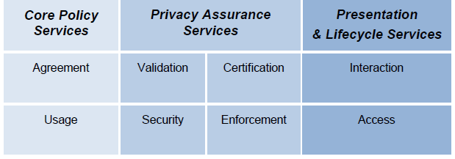
Step Four
Select Privacy Management Services

Slide 23
SERVICE | FUNCTIONALITY | INFORMAL DEFINITION
AGREEMENT | Define and document permissions and rules for the handling of PI based on applicable policies, individual preferences, and other relevant factors; provide relevant Actors with a mechanism to negotiate or establish new permissions and rules; express the agreements for use by other Services | Manage and negotiate permissions and rules
USAGE | Ensure that the use of PI complies with the terms of any applicable permission, policy, law or regulation, including PI subjected to information minimization, linking, integration, inference, transfer, derivation, aggregation, and anonymization over the lifecycle of the use case | Control PI use
VALIDATION | Evaluate and ensure the information quality of PI in terms of Accuracy, Completeness, Relevance, Timeliness and other relevant qualitative factors | Check PI
CERTIFICATION | Validate the credentials of any Actor, Domain, System or Subsystem, or system component involved in processing PI; verify compliance and trustworthiness of that Actor, Domain, System or Subsystem, or system component against defined policies | Check credentials
ENFORCEMENT | Initiate response actions, policy execution, and recourse when audit controls and monitoring indicate that an Actor or System does not conform to defined policies or the terms of a permission (agreement) | Monitor and respond to audited exception conditions
SECURITY | Provide the procedural and technical mechanisms necessary to ensure the confidentiality, integrity, and availability of personal information; make possible the trustworthy processing, communication, storage and disposition of privacy operations | Safeguard privacy information and operations
INTERACTION | Provide generalized interfaces necessary for presentation, communication, and interaction of PI and relevant information associated with PI; encompasses functionality such as user interfaces, system-to-system information exchanges, and agents | information presentation and communication
ACCESS | Enable data-subject Actors, as required and/or allowed by permission, policy, or regulation, to review their PI that is held within a Domain and propose changes and/or corrections to their PI | View and propose changes to stored PI

Slide 24
Select Mechanisms Supporting the Services
  Define the Business Process and Technical Mechanisms Needed to Support Services
  Implementation Functions and Technologies
  Business Practices

Slide 25
Iterative Risk Analysis
  Detailed Operational Risk Assessment across Use Case and PI Lifecycle
  Lifecycle Weaknesses and Risk Evaluation
  Control, Mechanisms, Operational requirements Policy and Other Modifications

Slide 26
Use Case example
Thank you
John.t.sabo@ca.com
www.ca.com
www.oasis-open.org

Slide 27
Additional
Considerations:
Operational FIP/Ps

Slide 28
Operational FIP/Ps (1)
Accountability: Functionality enabling reporting by the business process and technical systems which implement privacy policies, to the individual or entity accountable for ensuring compliance with those policies, with optional linkages to redress and sanctions.
Notice: Functionality providing Information, in the context of a specified use, regarding an entity’s privacy policies and practices including: definition of the Personal Information collected; its use (purpose specification); its disclosure to parties within or external to the entity; practices associated with the maintenance and protection of the information; options available to the individual regarding the collector’s privacy practices; retention and deletion; changes made to policies or practices; and other information provided to the individual at designated times and under designated circumstances.

Slide 29
Operational FIP/Ps (2)
Consent: Functionality, including support for Sensitive Information, Informed Consent, Change of Use Consent, and Consequences of Consent Denial, enabling individuals to agree to allow the collection and/or specific uses of some or all of their Personal Information either through an affirmative process (opt-in) or implied (not choosing to opt-out when this option is provided).
Collection Limitation and Information Minimization: Functionality exercised by the information collector or information user to limit the information collected, processed, communicated and stored to the minimum necessary to achieve a stated purpose and, when required, demonstrably collected by fair and lawful means.

Slide 30
Operational FIP/Ps (3)
Use Limitation: Functionality exercised by the information collector or information user to ensure that Personal Information will not be used for purposes other than those specified and accepted by the individual or provided by law, and not maintained longer than necessary for the stated purposes.
Disclosure: Functionality enabling the release, transfer, provision of access to, use for new purposes, or divulging in any other manner, Personal Information held by an entity in accordance with notice and consent permissions and/or applicable laws and functionality making known the information collectors policies to external parties receiving the information.
Access and Correction: Functionality allowing individuals having adequate proof of identity to discover from an entity, or discover and/or correct or delete, their Personal Information, at specified costs and within specified time constraints; and functionality providing notice of denial of access and options for challenging denial when specified.

Slide 31
Operational FIP/Ps (4)
Security/Safeguards: Functionality that ensures the confidentiality, availability and integrity of Personal Information collected, used, communicated, maintained, and stored; and that ensures specified Personal Information will be de-identified and/or destroyed as required.
Information Quality: Functionality that ensures that information collected and used is adequate for purpose, relevant for purpose, accurate at time of use, and, where specified, kept up to date, corrected or destroyed.
Enforcement: Functionality ensuring compliance with privacy policies, agreements and legal requirements and to give individuals a means of filing complaints of compliance violations and having them addressed, including recourse for violations of law, agreements and policies.
Openness: Functionality making availability to individuals the information collector's or information user's policies and practices relating to their management of Personal Information and for establishing the existence of, nature and purpose of use of Personal Information held about the individuals.

Slide 32
Operational FIP/Ps (5)
Anonymity: Functionality which renders personal information anonymous so that an individual is no longer identifiable.
Information Flow: Functionality enabling the communication of personal information across geo-political jurisdictions by private or public entities involved in governmental, economic, social or other activities.
Sensitivity: Functionality that provides special handling, processing, security treatment or other treatment of specified information, as defined by law, regulation or policy.

